Slide 1
Informal Design Guidelines for Relational Databases (2)
We first discuss informal guidelines for good relational design
Then we discuss formal concepts of functional dependencies and normal forms
- 1NF (First Normal Form)
- 2NF (Second Normal Form)
- 3NF (Third Normal Form)
- BCNF (Boyce-Codd Normal Form)
Additional types of dependencies, further normal forms, relational design algorithms by synthesis are discussed in Chapter 11

Slide 2
1.1 Semantics of the Relation Attributes
GUIDELINE 1: Informally, each tuple in a relation should represent one entity or relationship instance. (Applies to individual relations and their attributes).
Attributes of different entities (EMPLOYEEs, DEPARTMENTs, PROJECTs) should not be mixed in the same relation
Only foreign keys should be used to refer to other entities
Entity and relationship attributes should be kept apart as much as possible.
Bottom Line: Design a schema that can be explained easily relation by relation. The semantics of attributes should be easy to interpret.

Slide 3
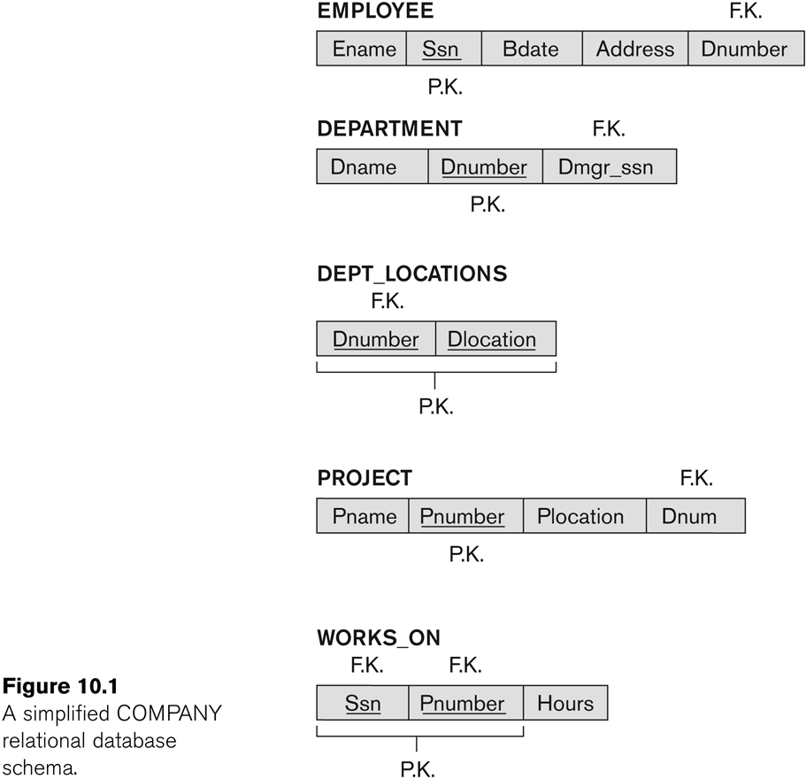
Figure 10.1 A simplified COMPANY relational database schema

Slide 4
1.2 Redundant Information in Tuples and Update Anomalies
Information is stored redundantly
Wastes storage
Causes problems with update anomalies
Insertion anomalies
Deletion anomalies
Modification anomalies

Slide 5
EXAMPLE OF AN UPDATE ANOMALY
Consider the relation:
EMP_PROJ(Emp#, Proj#, Ename, Pname, No_hours)
Update Anomaly:
Changing the name of project number P1 from “Billing” to “Customer-Accounting” may cause this update to be made for all 100 employees working on project P1.

Slide 6
EXAMPLE OF AN INSERT ANOMALY
Consider the relation:
EMP_PROJ(Emp#, Proj#, Ename, Pname, No_hours)
Insert Anomaly:
Cannot insert a project unless an employee is assigned to it.
Conversely
Cannot insert an employee unless an he/she is assigned to a project.

Slide 7
EXAMPLE OF AN DELETE ANOMALY
Consider the relation:
EMP_PROJ(Emp#, Proj#, Ename, Pname, No_hours)
Delete Anomaly:
When a project is deleted, it will result in deleting all the employees who work on that project.
Alternately, if an employee is the sole employee on a project, deleting that employee would result in deleting the corresponding project.

Slide 8
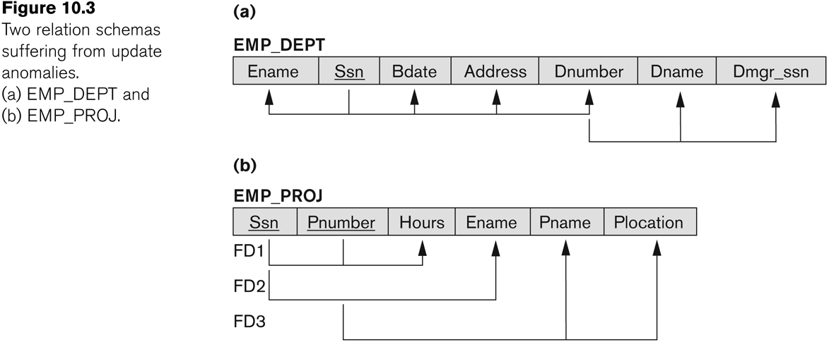
Figure 10.3 Two relation schemas suffering from update anomalies

Slide 9
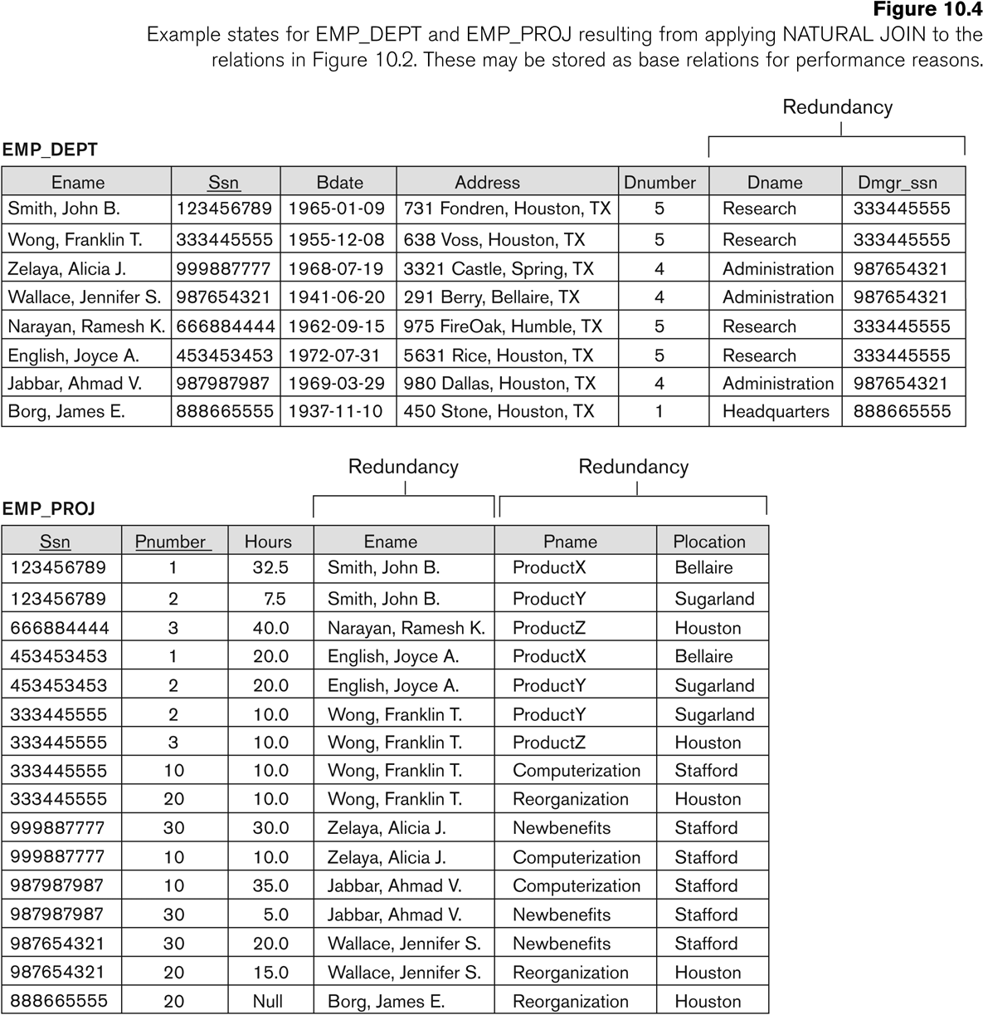
Figure 10.4 Example States for EMP_DEPT and EMP_PROJ

Slide 10
Guideline to Redundant Information in Tuples and Update Anomalies
GUIDELINE 2:
Design a schema that does not suffer from the insertion, deletion and update anomalies.
If there are any anomalies present, then note them so that applications can be made to take them into account.

Slide 11
1.3 Null Values in Tuples
GUIDELINE 3:
Relations should be designed such that their tuples will have as few NULL values as possible
Attributes that are NULL frequently could be placed in separate relations (with the primary key)
Reasons for nulls:
Attribute not applicable or invalid
Attribute value unknown (may exist)
Value known to exist, but unavailable

Slide 12
1.4 Spurious Tuples
Bad designs for a relational database may result in erroneous results for certain JOIN operations
The "lossless join" property is used to guarantee meaningful results for join operations
GUIDELINE 4:
The relations should be designed to satisfy the lossless join condition.
No spurious tuples should be generated by doing a natural-join of any relations.

Slide 13
Functional Dependencies (2)
X -> Y holds if whenever two tuples have the same value for X, they must have the same value for Y
For any two tuples t1 and t2 in any relation instance r(R): If t1[X]=t2[X], then t1[Y]=t2[Y]
X -> Y in R specifies a constraint on all relation instances r(R)
Written as X -> Y; can be displayed graphically on a relation schema as in Figures. ( denoted by the arrow: ).
FDs are derived from the real-world constraints on the attributes

Slide 14
Examples of FD constraints (1)
Social security number determines employee name
SSN -> ENAME
Project number determines project name and location
PNUMBER -> {PNAME, PLOCATION}
Employee ssn and project number determines the hours per week that the employee works on the project
{SSN, PNUMBER} -> HOURS

Slide 15
Examples of FD constraints (2)
An FD is a property of the attributes in the schema R
The constraint must hold on every relation instance r(R)
If K is a key of R, then K functionally determines all attributes in R
(since we never have two distinct tuples with t1[K]=t2[K])

Slide 16
2.2 Inference Rules for FDs (1)
Given a set of FDs F, we can infer additional FDs that hold whenever the FDs in F hold
Armstrong's inference rules:
IR1. (Reflexive) If Y subset-of X, then X -> Y
IR2. (Augmentation) If X -> Y, then XZ -> YZ
(Notation: XZ stands for X U Z)
IR3. (Transitive) If X -> Y and Y -> Z, then X -> Z
IR1, IR2, IR3 form a sound and complete set of inference rules
These are rules hold and all other rules that hold can be deduced from these

Slide 17
Inference Rules for FDs (2)
Some additional inference rules that are useful:
Decomposition: If X -> YZ, then X -> Y and X -> Z
Union: If X -> Y and X -> Z, then X -> YZ
Psuedotransitivity: If X -> Y and WY -> Z, then WX -> Z
The last three inference rules, as well as any other inference rules, can be deduced from IR1, IR2, and IR3 (completeness property)

Slide 18
Inference Rules for FDs (3)
Closure of a set F of FDs is the set F⁺ of all FDs that can be inferred from F
Closure of a set of attributes X with respect to F is the set X⁺ of all attributes that are functionally determined by X
X⁺ can be calculated by repeatedly applying IR1, IR2, IR3 using the FDs in F

Slide 19
Closure of an attribute x is the set of all attributes that are functional dependencies on X with respect to F. It is denoted by X⁺ which means what X can determine.
Algorithm
Let’s see the algorithm to compute X⁺
Step 1 − X⁺ =X
Step 2 − repeat until X⁺ does not change
For each FD Y->Z in F
If Y ⊆ X⁺ then X⁺ = X⁺ U Z

Slide 20
Consider a relation R(A,B,C,D,E,F)
F: E->A, E->D, A->C, A->D, AE->F, AG->K.
Find the closure of E or E+
Solution
The closure of E or E+ is as follows −
E+ = E
=EA {for E->A add A}
=EAD {for E->D add D}
=EADC {for A->C add C}
=EADC {for A->D D already added}
=EADCF {for AE->F add F}
=EADCF {for AG->K don’t add k AG ⊄ D+)

Slide 21
For the following relation schema R and set of Functional Dependencies F:
R(A,B,C,D,E), F = {AC → E, B → D, E → A}
List all candidate keys.

Slide 22
Closure of F (F+): F+ is the set of all FDs that can be inferred/ derived from F. Using Armstrong Axioms repeatedly on F, we can compute all the FDs.
Example
R(A,B,C,D,E) AND F: A->B,B->C, C->D, A->E. Find the closure of F
Solution
A+= {A,B,C,D,E}
B+= {B,C,D}
C+= {C,D}
F+= {A->A, A->B, A->C, A->D, A->E, B->B, B->C, B->D, C->C, C->D}

Slide 23
Minimal Cover
A minimal cover is a simplified and reduced version of the given set of functional dependencies. Since it is a reduced version, it is also called as Irreducible set. It is also called as Canonical Cover.
Steps to Find Minimal Cover
1) Split the right-hand attributes of all FDs. Example A->XY => A->X, A->Y
2) Remove all redundant FDs. Example { A->B, B->C, A->C } Here A->C is redundant since it can already be achieved using the
Transitivity Property.
3) Find the Extraneous attribute and remove it. Example
AB->C, either A or B or none can be extraneous. If A closure contains B then B is extraneous and it can be removed. If B closure contains A then A is extraneous and it can be removed.

Slide 24
Consider an example to find minimal cover of F.
The given functional dependencies are as follows
A -> BC , B -> C , A -> B ,AB -> C
First step − Convert RHS attribute into singleton attribute.
A -> B ,A -> C,B -> C, A -> B ,AB -> C
Second step − Remove the extra LHS attribute
Find the closure of A.
A+ = {A, B, C}
So, AB -> C can be converted into A -> C
A -> B , A -> C ,B -> C ,A -> B ,A -> C
Third step − Remove the redundant FDs.
A -> B, B -> C

Slide 25
2.4 Minimal Sets of FDs (1)
A set of FDs is minimal if it satisfies the following conditions:
Every dependency in F has a single attribute for its RHS.
We cannot remove any dependency from F and have a set of dependencies that is equivalent to F.
We cannot replace any dependency X -> A in F with a dependency Y -> A, where Y proper-subset-of X ( Y subset-of X) and still have a set of dependencies that is equivalent to F.

Slide 26
Minimal Sets of FDs (2)
Every set of FDs has an equivalent minimal set
There can be several equivalent minimal sets
There is no simple algorithm for computing a minimal set of FDs that is equivalent to a set F of FDs
To synthesize a set of relations, we assume that we start with a set of dependencies that is a minimal set

